Slide 1
CCMS and L10N Workflows
Boston DITA Users Group , April 10, 2019
Georg Kirchner

Slide 2
Translating DITA XML Content
Intro
Translation roundtrip from perspective of
  Author
  Localization engineering
  Localization project manager
  Translator
  DTP engineer
Scope of presentation: 1 of 3 translation environments at Dell Technologies
Q&A
Notes:
FM > RoboHelp > RoboHTML > DocBook > DITA (Arbortext):
Push-button publishing enabling sim shipping source and target languages
Georg will step through the roundtrip of DITA XML content between a version control system/publishing environment and a translation management system to create multi-language content. Along the workflow steps, Georg will point out opportunities for the automation of tasks such as change detection, filtering for translatable text, re-using translation, DTD validation of translated XML files, localizing graphics, and iterating output generation.
Processes:
Roundtrip between CCMS and TMS
L10N workflow
Change detection at file level and translation job creation
Automated file exchange between CCMS and TMS
Preprocessing of source language files
Change detection at sentence level: filtering for and segmenting of translatable text
Reuse of translations of un/changed words
Automated translation (NMT) of new words
Best practices for authors to write for [machine] translation
XML validation: CAT tool, offline against DTD, during import to CCMS
Push-button publishing: iterative
Completing workflows in TMS and CCMS

Slide 3
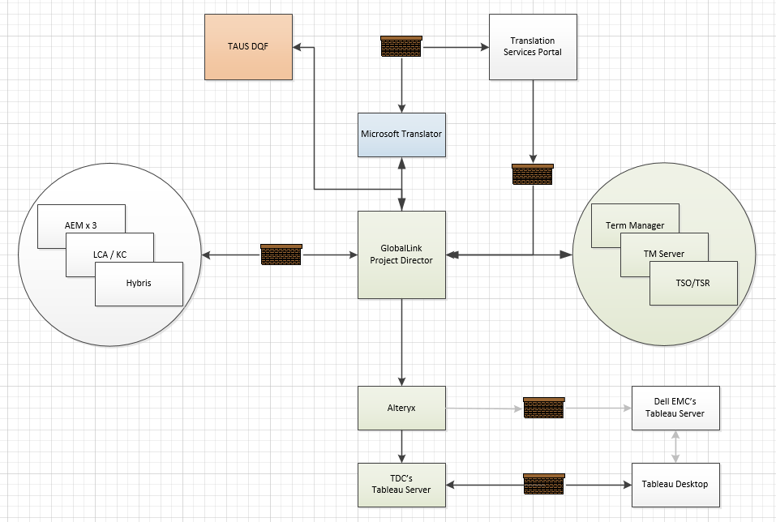
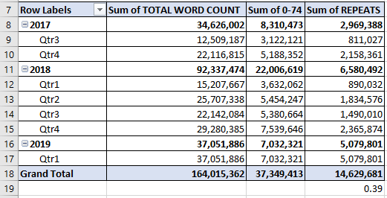
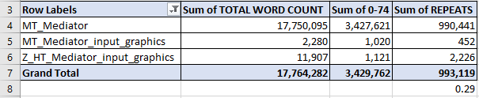
DITA XML in L10N technology footprint and volume
Over last 20 months in this environment, DITA XML was 10% of overall HT+MT+PE translation throughput
Notes:
DITA XML in translation technology footprint
Explain translation management system (TMS)
DITA XML a fraction of translation throughput in this one environment

Slide 4
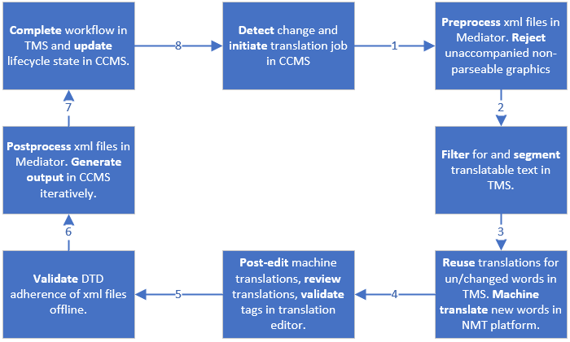
Processes: CCMS <> TMS Roundtrip
Notes:
High-level overview of the translation roundtrip between the CCMS and TMS (Translation Management System)

Slide 5
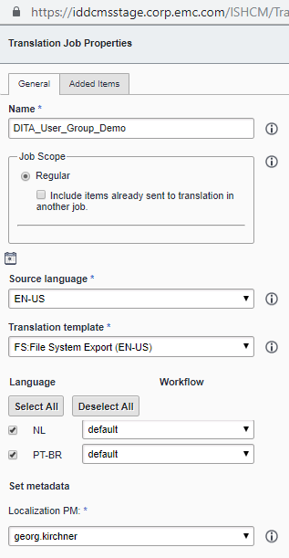
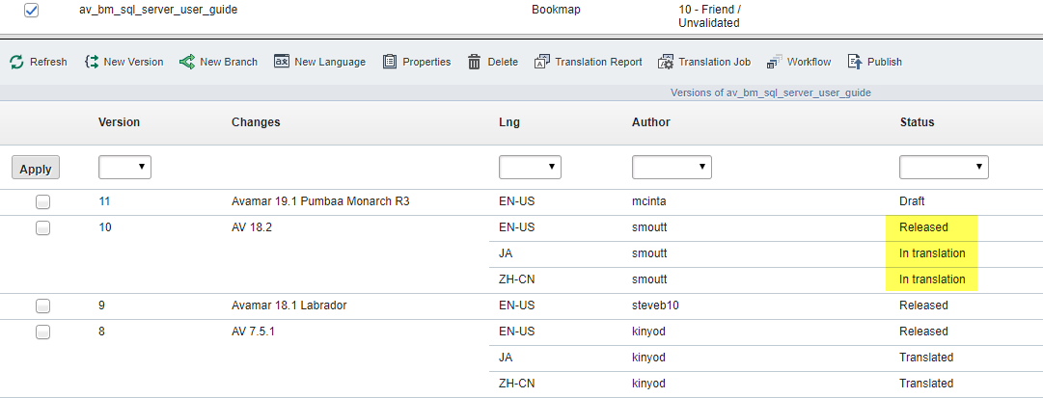
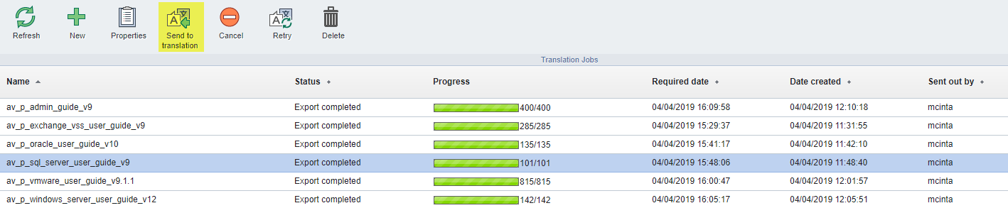
Released, To be Translated, In Translation, Translated
The lifecycle states of a translatable object in the CCMS
Notes:
Translation lifecycle states reflect the translation roundtrip on the previous slide.
Setting a translatable object to “Released” in will get it included in the next translation job initiated in the CCMS.

Slide 6
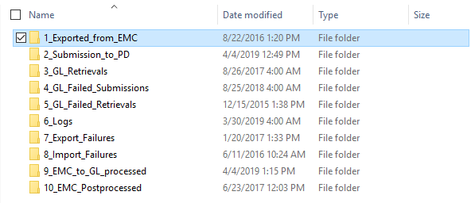
CCMS < > Integration Server <> TMS
Pre-processing and post-processing of payload
Notes:
The Archival folder visualizes best the steps taken on the Integration Server.
1_Exported* contains files as received from CCMS
2_Submission* contains pre-processed files: sort-as tags inserted, files renamed, files reorganized, manifest added, zip file created
3_GL_Retrievals contains translated files coming back from TMS
10_EMC* should really be 4_*. Contains post-processed files returned to CCMS
Each folder has scheduled Windows tasks configured.

Slide 7
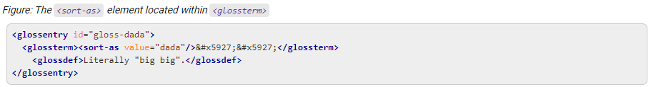
Preprocessing of source language files
Examples | Reason
Concatenate xml files | If translation editor opens 1 file at a time
Normalization of white spaces | To maximize translation reuse
Insert sort-as element | For sorting glossary entries in JA-JP or ZH-CN

Slide 8
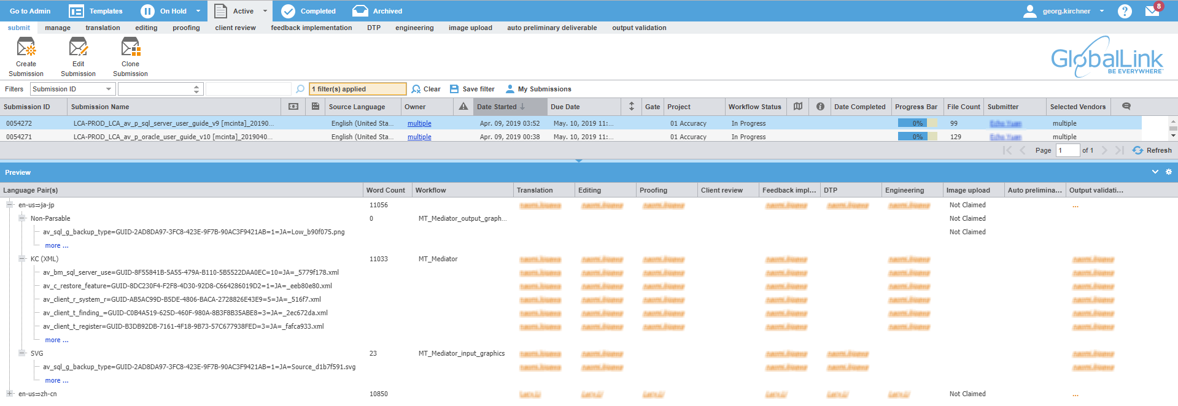
Three Workflow in TMS to Route Payload in 1 Job
Translatable xml files – input graphics – output graphics
Notes:
Explain organization of three file types in payload in batches, which all are mapped to purpose-built electronic workflows.

Slide 9
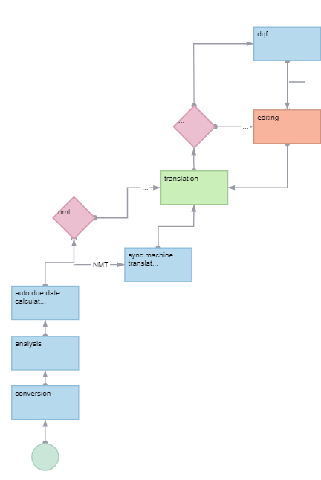
TMS workflow steps: early phases
Notes:
Explain beginning steps in the translation workflow.

Slide 10
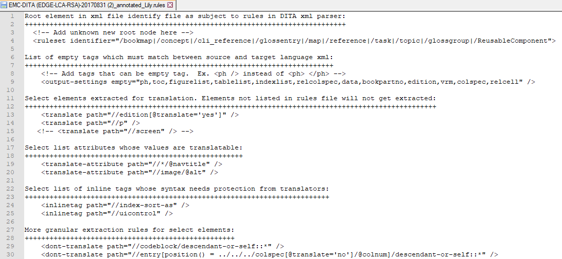
Filtering for and segmenting of translatable text
Notes:
Root elements are preceded by single forward slash (/)
Child elements are preceded by double forward slash (//)
Extraction of text is at paragraph level, governed by the rules file (a.k.a, parser, filter)
Segmentation of text is a second step, ruled in GL by TM configuration
#+++++++++++++++++++++++++++++++
# Segmentation Configuration
#+++++++++++++++++++++++++++++++
segmenter.simplifier.trados.strict=true
segmenter.simplifier.trados.noesp=true

Slide 11
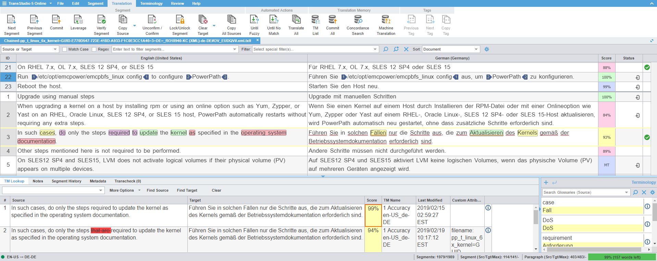
Reuse of translations for un/changed words
Notes:
This screenshot is from completed, and reopened submission #51097.
Look at score column for re-use information:
100%: reused from translation database (a.k.a., translation memory)
99% - 75%: reuse of similar sentences translated in the past. Translator needs to adjust proposed translations. In row 3 of the translation editor, the previous translation stored in the DB was of a version of the sentence that contained “that are”…
MT: these are matches below the 75% threshold. These sentences get pre-translated with a Neural-Network based machine translation system. Translators will correct as necessary, resulting in “post-edit” distance.

Slide 12
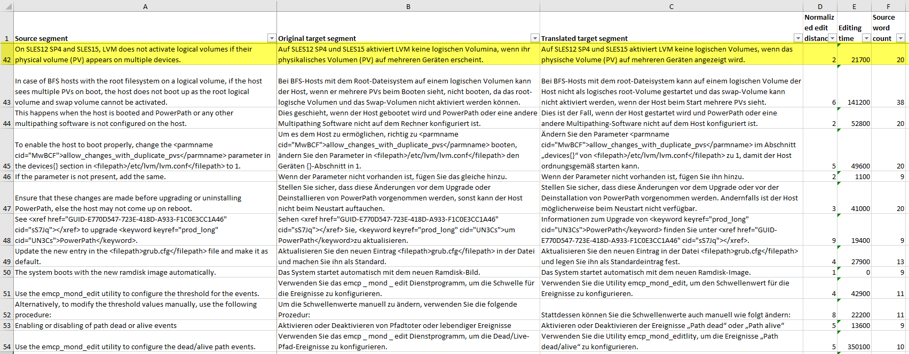
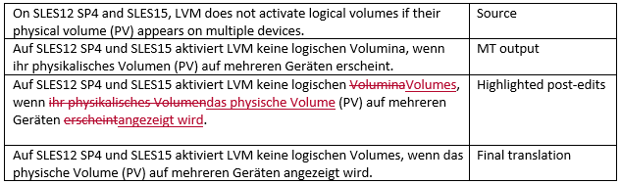
Automated translation (NMT) of new words
Notes:
Explain the task of post-editing machine-translated new words.

Slide 13
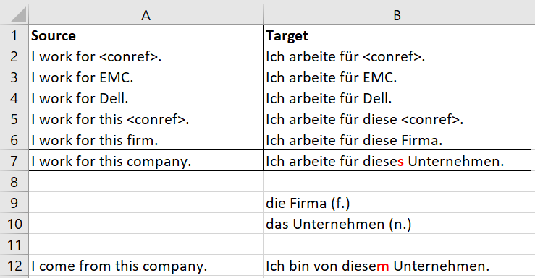
Best practices in writing for [machine] translation
Keep you sentences short: 10 – 25 words
Avoid noun clusters:
  service level agreement achievement percentage
  cloud service orchestration workflows
Use active voice
Use of conrefs for proper nouns and numbers only
  EMC, Dell EMC, vs. firm, company
Notes:
Proper nouns (e.g., Dell) vs. common nouns (e.g., firm) in context of conrefs.

Slide 14
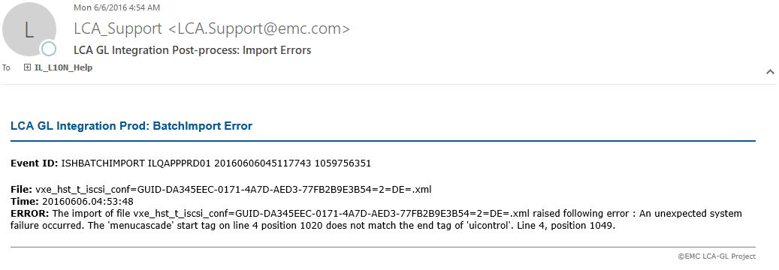
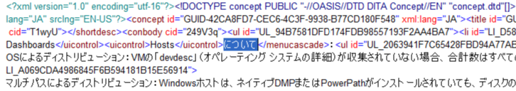
XML validation
Tag validation in translation editor
DTD validation offline in xml editor
Validation during import to CCMS
Translation outside of uicontrol, yet inside menucascade
Notes:
Altova XML Spy used for off-line DTD validation.

Slide 15
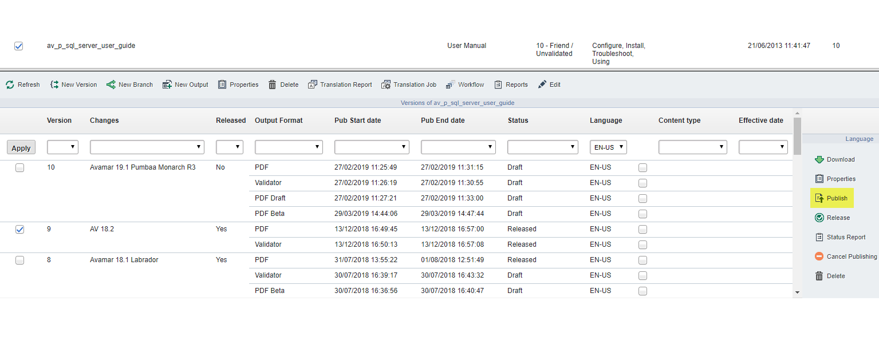
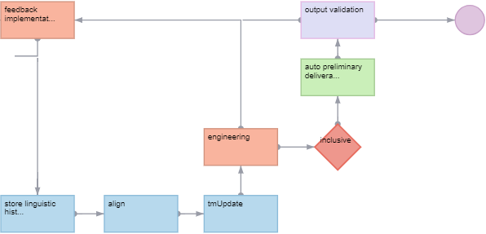
Push-button publishing: iterative
Notes:
Georg will step through the roundtrip of DITA XML content between a version control system/publishing environment and a translation management system to create multi-language content. Along the workflow steps, Georg will point out opportunities for the automation of tasks such as change detection, filtering for translatable text, re-using translation, DTD validation of translated XML files, localizing graphics, and iterating output generation.

