Slide 1
Improving Topic Reuse
Boston DITA Users Group
Stan Doherty, Ph.D.
Secretary Consulting Content Developer
OASIS DITA Adoption TC Oracle Cloud Infrastructure
Oracle Corporation
September 11, 2019
Notes:
This is a Title Slide with Picture slide ideal for including a picture with a brief title, subtitle and presenter information.
To customize this slide with your own picture:
Right-click the slide area and choose Format Background from the pop-up menu. From the Fill menu, click Picture and texture fill. Under Insert from: click File. Locate your new picture and click Insert.
To copy the Customized Background from Another Presentation on PC
Click New Slide from the Home tab's Slides group and select Reuse Slides.
Click Browse in the Reuse Slides panel and select Browse Files. Double-click the PowerPoint presentation that contains the background you wish to copy.
Check Keep Source Formatting and click the slide that contains the background you want.
Click the left-hand slide preview to which you wish to apply the new master layout.
Apply New Layout (Important): Right-click any selected slide, point to Layout, and click the slide containing the desired layout from the layout gallery.
Delete any unwanted slides or duplicates.
To copy the Customized Background from Another Presentation on Mac
Click New Slide from the Home tab's Slides group and select Insert Slides from Other Presentation…
Navigate to the PowerPoint presentation file that contains the background you wish to copy. Double-click or press Insert. This prompts the Slide Finder dialogue box.
Make sure Keep design of original slides is unchecked and click the slide(s) that contains the background you want. Hold Shift key to select multiple slides.
Click the left-hand slide preview to which you wish to apply the new master layout.
Apply New Layout (Important): Click Layout from the Home tab's Slides group, and click the slide containing the desired layout from the layout gallery.
Delete any unwanted slides or duplicates.

Slide 2
Agenda
1
What have we learned about DITA reuse?
How do teams set appropriate expectations?
How do teams approach content analysis?
How do teams refactor topics for reuse?
How do teams maintain reused content?
2
3
4
5

Slide 3
What have we learned about DITA reuse?
State of the union . . .
The OASIS DITA spec does not document reuse directly.
There is no definitive book on DITA reuse.
Best practices and use cases are scattered throughout conference
presentations, user group postings, and blogs.
Quality commercial training is available.
Experienced consultants are available.

Slide 4
What have we learned about DITA reuse?
State of the union . . .
In the absence of generally accepted best practices, mythology and
misinformation abound:
> Reuse is free.
> Reuse is guaranteed.
> Reuse is automatic.
> Reuse is relevant for every writer, project, and team.
> Any content, regardless of structure, style, architecture, or editorial style,
can be reused.
Reuse ROI is traditionally oversold. Reuse support under-resourced.

Slide 5
What have we learned about DITA reuse?
Individuals implement reuse – successful teams plan and sustain it
Successful teams focus on long-term, measurable increases in reuse %.
Successful teams focus on very specific, short-term goals.
Successful teams invest in reuse working groups to figure it out.
Successful teams rotate other team members through this reuse working group.
Successful teams like numbers – measuring and costing stuff.
Successful teams practice advocacy – writers identifying and advocating
that specific topics can be reused.
Successful teams learn from successes, learn from failures.
Successful teams develop a shared sense of what's "good enough".

Slide 6
How do teams set appropriate expectations?
Foundation work . . . define criteria for reuse and standards
Organize your reuse working group.
Develop a functional definition for content reuse:
> Only one copy/version of the topic content anywhere in repo.
> Topics integrate with multiple contexts (maps) without writer intervention.
> Topics integrate with multiple contexts (maps) in various ways:
- Identical content in each context.
- Conditionalized or transcluded content adapts to each context.
- Dynamically assembled content assembled for each context.
Develop a functional formula to measure reuse within each deliverable:
> Total # delivered words / total # source words (referenced)
Identify and engage down-stream stakeholders:
> Localization
> Support

Slide 7
How do teams set appropriate expectations?
Foundation work . . . define criteria for reuse and standards
Establish and socialize your overall reuse development workflow (phases):
> Training -- reuse working group and supporters
> Content analysis – identifying reuse zones in your overall content
> Reuse techniques – best practices and supporting training
> Implementation – code it and measure it
> Curation/maintenance – revisit the scope of existing reused content
Q1
Q2
Q3
Q4
Training
Content analysis
Reuse techniques
Implementation
Curation/maintenance

Slide 8
How do teams set appropriate expectations?
Foundation work . . . define criteria for reuse and standards
Resolve the degrees to which you are refactoring content for:
> Minimalism – allows you to remove or hide non-essential information
> More generic writing – allows you to soften some differences
between contexts
> Technical debt – writing issues that you have never had time to address
Sanity check your goals and commitments against your available resources.
Shrink to fit.
> Prioritize (in writing)
> Defer (in writing)
> Decommit (in writing)

Slide 9
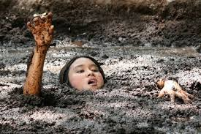
How do teams set appropriate expectations?
Above all . . . be not a schmuck!!
If your management team is unwilling or unable to invest in your team
efforts around reuse . . . don't do it. Revisit the budget periodically.

Slide 10
How do teams approach content analysis?
Specify formally what you are looking for . . .
Look beyond shared topic features or subjects.
Focus on specific information (topic) types: tasks, reference, concepts.
Identify your target granularity for reuse:
> Collections of topics relevant to multiple contexts
> Individual topics relevant to multiple contexts
> <section>s in shared libraries that are relevant to multiple contexts
Quantify obstacles to reuse in a set of candidate topics:
> See Stan Doherty, Counting Dragons: Quantifying Obstacles to Content Reuse
(CIDM Newsletter, Spring 2018).
> Contextual referencing:
- Ratios of words:xrefs, words:conrefs, words:conditions
- Ratios of screen images per topic
> Update frequency per year
If available, review web analytics about current customer usage.

Slide 11
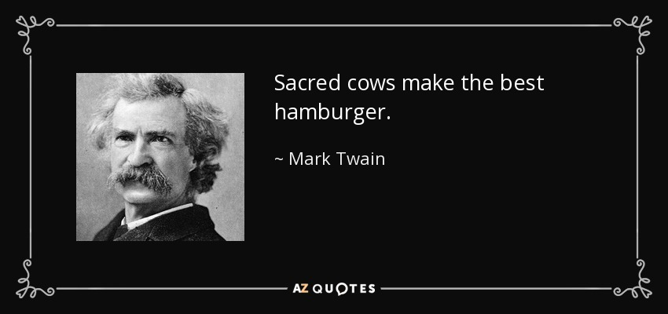
How do teams approach content analysis?
Inventory and challenge recurring editorial / architectural issues
Editorial issues:
> Tone/style: formal, informal, conversational
> Conventions for topic and section titles:
- Tasks: gerunds, infinitives, "How to"s, or imperatives
- Concepts: "About"
> Transitions
> Linking conventions: "For more information about XXX, see YYY."

Slide 12
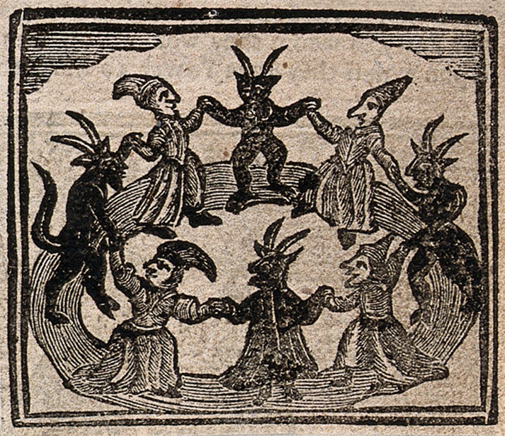
How do teams approach content analysis?
Inventory and challenge recurring editorial / architectural issues
XML/architectural issues:
> Short description conventions and usage
> <prolog> metadata conventions and usage
> Specializations:
- Within one organization/team
- Across organizations and teams
> Element building blocks (templates) for each genre of writing:
- User Guides/Help
- API/SDK/Programming
- Tutorial/Getting Started/OBEs
Each demon we invite to
the forest dance we
know by name.
1720 woodcut

Slide 13
How do teams approach content analysis?
Propose a reuse refactoring method for each set of candidates
Route candidates toward a specific refactoring method:
> Rewrite existing variants
into one all-purpose, reusable topic.
> Merge existing variants into one
super-topic with conditions.
> Push variant content to separate,
reference-able library blocks.
> Store variants as key-based
content.
BEFORE AFTER
A
B
D
A B C
C
A
B
A
B
C
D
C
A
B
A
B
C
D
C
LIBRARY
A
B
A
B
C
D
C
KEY DEFINITION
MAP

Slide 14
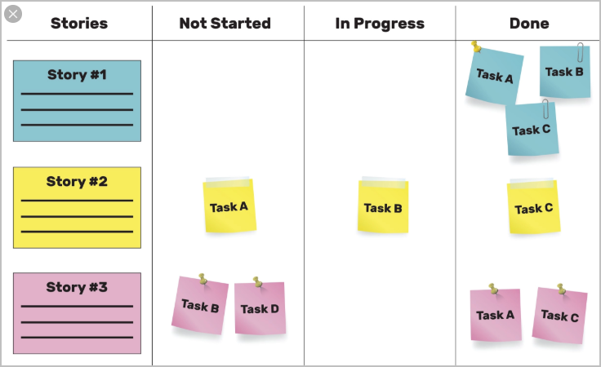
How do teams approach content analysis?
Make your analysis visible – invite comments
Track each reuse candidate through your analysis process/workflow.
If possible, quantify the ROI before you do the refactoring work.

Slide 15

How do teams refactor topics for reuse?
It's all about tagging and bagging variations . . .
Copy each reuse candidate topic, library, or key definition map into a
separate branch or repo.
In a side-by-side analysis, tag each element that contains variant content.
Correlate and resolve variant elements into a new topic.
> Rewrite/merge C1, B3
> Conditionalize A2, B2, and C2
> Remove A1, A3, and C3
Somehow tag the new topic as being "shared" between A, B, and C contexts.
Send the new topic out for review.
A
A1
A2
A3
B1
B2
B3
Consider tagging each variant in your sources.
<ph audience="hidden">{B1} </ph>
B
C
C1
C2
C3

Slide 16
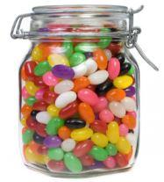
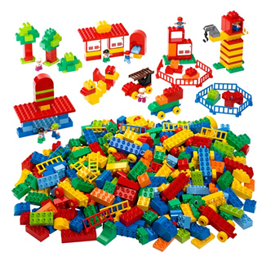
How do teams maintain reused content?
Two approaches seem prevalent . . .
Jelly beans in the jar . . . Lego pieces on the shelf . . .
Each time a topic gets refactored
for reuse, it gets dropped into
a folder.
Little or no periodic review.
Fades away with a whimper.
Each time a topic gets refactored
for reuse, it is put on a shelf for
everyone to see.
Periodically, each assembly is
evaluated.
As necessary, assembly pieces
are rearranged or replaced.

Slide 17
Semi-relevant quotations . . .
Love is work: "When we love something, it is of value to us and when something is of value to us, we spend time with it, time enjoying it and time taking care of it. . . . By far the most common and important way in which we can exercise our attention is by listening. . . . An essential part of true listening is the discipline of bracketing, the temporary giving up or setting aside of one’s own prejudices, frames of reference and desires so as to experience as far as possible the speaker’s world from the inside, stepping inside his or her shoes.
M. Scott Peck, The Road Less Traveled 1978
The daily Examen of faith: "Ask account of your soul from the hour that you rose up to the present moment, hour by hour, or period by period -- first as to thoughts, and then as to words, and then as to acts."
Ignatius of Loyola, Spiritual Exercises 1548
Generosity: A tree is a wonderful living organism which gives shelter, food, warmth and protection to all living things. It even gives shade to those who wield an axe to cut it down.
Siddhartha Guatama Buddha

Slide 18
Semi-relevant quotations . . .
REUSE
Love is work: "When we love something, it is of value to us and when something is of value to us, we spend time with it, time enjoying it and time taking care of it. . . . By far the most common and important way in which we can exercise our attention is by listening. . . . An essential part of true listening is the discipline of bracketing, the temporary giving up or setting aside of one’s own prejudices, frames of reference and desires so as to experience as far as possible the speaker’s world from the inside, stepping inside his or her shoes.
M. Scott Peck, The Road Less Traveled 1978
The daily Examen of faith: "Ask account of your soul from the hour that you rose up to the present moment, hour by hour, or period by period -- first as to thoughts, and then as to words, and then as to acts."
Ignatius of Loyola, Spiritual Exercises 1548
Generosity: A tree is a wonderful living organism which gives shelter, food, warmth and protection to all living things. It even gives shade to those who wield an axe to cut it down.
Siddhartha Guatama Buddha
REUSE
REUSE

