Slide 1
From Book-Think to Topic-Think
Change the way you look at things and the things you look at change.
-Wayne W. Dyer, Author
Presented by Mark Decker
Principal Technical Writer - Oracle
Notes:
By my best estimate, I’ve attended hundreds of presentations throughout my several careers. In all that time I’ve never had the urge to be a presenter. Then one day at a Boston DITA User Group meeting, I answered Stan’s call for ideas for meeting topics. I didn’t mean to, but I did. When Stan asked if I might be a presenter on the topic that I suggested, it felt right to say yes.
It felt right because I’ve seen too many of my fellow tech writers struggle with the transition to DITA where they had to step away from the mindset of writing books, chapters, and sections to writing standalone topics.
I observed that the main hurdle seemed to be the switch to separating content from architecture during the writing phase. In other words, going from book-think to topic-think. Which brings us to today’s topic about transitioning from approaching documentation projects from top down to bottom up. In the beginning, you might wonder: How do we approach this? Does this really work?” I plan to answer those questions today.

Slide 2
It’s a change of focus
DITA separates content from design and architecture.
Think of design and architecture as different subjects for a different time, after the writing is done.
When you sit down to write, think only about the topic you are writing.
Clear your mind of architecture.
Notes:
Among other things, DITA separates content from design and architecture. To me the separation of content makes life easier because when I sit down to write all I have to think about is the writing…and even better in my opinion… is that all I have to think about is writing one topic.
This shift in approach was the key to my pivot away from book-think to topic-think. Really, quite suddenly the task of writing became less onerous…all I have to think about is one topic…the one I’m working on. That was a freeing thought.
Just think topic when you write. Clear your mind of architecture.

Slide 3
What is a topic?
Quoting from the OASIS DITA Architectural Specification v1.0 docs.oasis-open.org
DITA topics are the basic units of DITA content. Each topic should be organized around a single subject.
A topic is a unit of information with a title and content, short enough to be specific to a single subject or answer a single question, but long enough to make sense on its own and be authored as a unit.
A document may contain one topic or multiple topics, and a document type may support authoring one or many kinds of topics. But regardless of where they occur, all topics have the same basic structure and capabilities.
Notes:
OASIS = Organization for the Advancement of Structured Information Standards
A topic is the basic unit for writing content. It is the smallest artifact in our documentation.
Later, after the writing, you can place the topics into books, PDF files, Websites, and Help sets, as needed. That’s all for the future.

Slide 4
Where is the bottom in “from the bottom up”?
Think of topics as cement blocks that you will use to build the foundation of a house.
Think of making each block and setting it aside until you have all that you need to build something.
The blocks might have different purposes, so you will make different shapes and sizes.
Like a cinder block, write the topic to stand alone with no dependencies. (No “This chapter”, This section”, “As noted in the previous topic…”, or anything else that makes the topic dependent.)
Notes:
Dad building our first house, making each cinder block. Then assembling them to make the foundation.
Each block can stand alone or be used as part of something greater. So it goes for topics.
As I mentioned, you can assemble the topics later in the foundation your deliverable. But, for the present we want to ensure re-usability. That is why we want to write the topics to stand alone.

Slide 5
The types of DITA topics
Concept – Use to explain the purpose of something. “What” and “Why”
Call Traffic Management with Access Control Lists
Bridge – Use to introduce a process made of several tasks.
The <product> Deployment Process
Task – Use to provide the steps for performing a task. “How To”
Add an Access Control List
Reference – Use to catalog information such as parameter descriptions and command line objects.
Policy Decision Engine Configuration Parameters
Notes:
Concept-The feature is called Access Control Lists. The user goal is to manage inbound and outbound calls to the enterprise by creating lists of phone numbers to allow, block redirect, and throttle. So, my topic title is not Access Control Lists. It’s Call Traffic Management with Access Control Lists.
Bridge-The <product> Deployment Process
Task–Add an Access Control List.
Reference-Policy Decision Engine Configuration Parameters

Slide 6
Concept Topic
Used to introduce a product or feature and explain essential terminology and technology.
Answer the questions, What is this? What does it do? Why might the user want to use this feature? WIIFM
Keep the focus on the user’s goals.
Avoid gerunds in the title. (They cause ambiguity)
If lengthy, you might need to break it down into smaller topics.
Notes:
What’s In It For Me

Slide 7
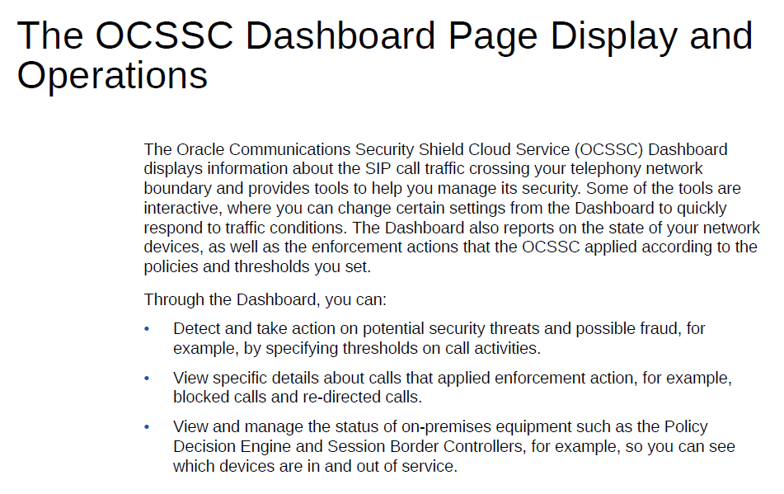

Slide 8
Task Topic
Answer the question, “Why do I want to do this and how do I do it?
Use a simple structure that contains actions the user needs to perform to reach a result.
The title begins with an imperative verb. Configure, Add, Create
The short description can answer the questions.
You can add context, but only about the task. Do not include background information about the product, features of the product, or specific information about the product or feature, such as specifications or descriptions of parameters.

Slide 9
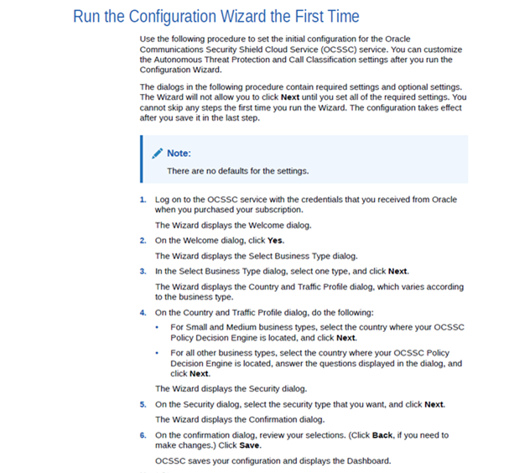

Slide 10
Bridge Topic
Use to introduce a process that includes several tasks
Describes the process, not the concepts of the feature or product or the details of individual tasks.
List the tasks and give a brief statement of their order or purpose.
Link to the task topics
Avoid a gerund in the title.
Notes:
Describer neither the concepts nor the details of the individual tasks.

Slide 11
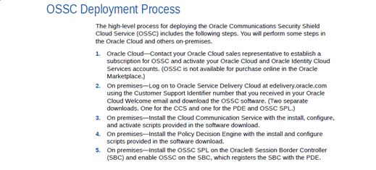
Notes:
Links

Slide 12
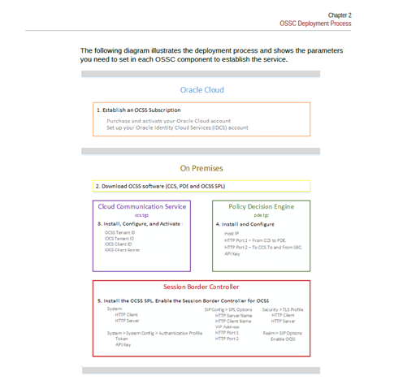

Slide 13
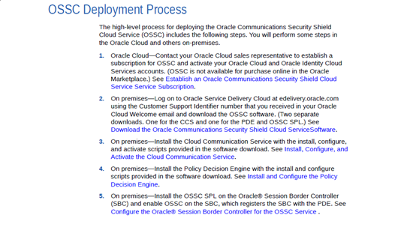

Slide 14
Reference Topic
Contains specific information, such as values. Often presented as a table or glossary-style term and definition format….handy for cataloging and describing parameters.
Can contain commands in a programming language, error messages, traps, or a table containing software and hardware settings. Avoid gerunds in the title.

Slide 15
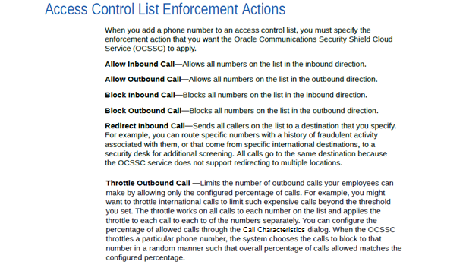

Slide 16
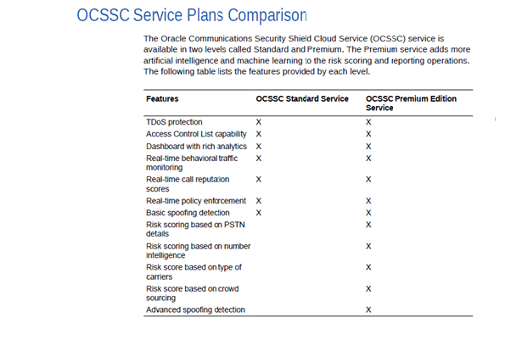

Slide 17
What’s next, after the writing?
Work on the architecture of the deliverable.
But, that’s beyond our scope today.
Notes:
We’ve reached the end of the writing discussion. What comes next is building the architecture of the deliverable. That’s a conversation for another time.

Slide 18
Thank You
mark.decker@oracle.com

Slide 19
Orientation Topic
Used to begin a chapter; but write this last…after the other types of topics are written…so that you don’t use it to impose architecture (That’s book-think). It is an intro to…and a summary of…the content you link it to. It is to a chapter what the short description is to a topic. It may take some practice to get the hang of it.
Do not start with “This chapter covers….” (That’s book-think) That makes the topic dependent and thus not reusable. Just write the content and end with the links to the associated topics.
Avoid gerunds in the title. Write a good, descriptive title.
List the links to the related topics.

Slide 20
