Slide 1


FROM THE GROUND UP
Solving content redesign challenges with the AEM Guides CMS

Slide 2
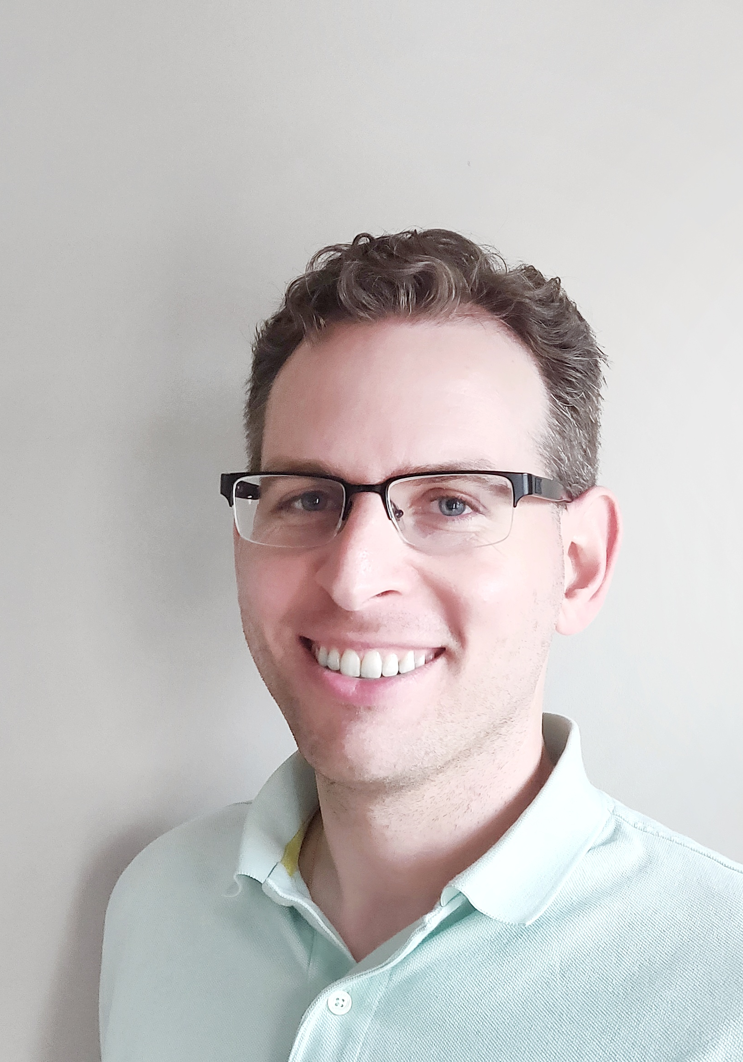
WELCOME!
Marco Cacciacarro, Docs Manager & Sr Tech Writer
BlackBerry Enterprise Docs
docs.blackberry.com

Slide 3


Slide 4
Background
2019: BlackBerry acquires Cylance, adopts Protect Desktop and Optics
Late 2020 into 2021: BlackBerry releases Protect Mobile, Persona Desktop, Gateway; standalone docs for each product
2021: Push for a unified product vision
November 2021: Docs delivers a unified CES doc set

Slide 5

CHALLENGE #1: GETTING ON THE
SAME PAGE
Cylance content migrated from MadCap Flare, out of synch with other BlackBerry docs
Style and structural differences across the standalone docs
How to resolve these differences and deliver docs with a consistent structure and voice?

Slide 6
CHALLENGE #1: GETTING ON THE SAME PAGE
Using Conrefs to:
  Align on branding
  Enforce first instance and subsequent instance product names (“BlackBerry Gateway” vs. “Gateway”)
  Achieve consistency via QA review
New DITA templates for a common voice and style:
  Flow of topics for conceptual info
  New Release Notes template
  Common management tasks

Slide 7
CHALLENGE #1: GETTING ON THE SAME PAGE
Style decisions for DITA elements:
  Note elements for crucial information only
  Clear separation of concept, task, reference
  Standardize the elements and config for tables
  Eliminate “over-documentation” and itemizing the UI
  Standardize xrefs for internal and external links

Slide 8

CHALLENGE #2: KEEPING UP WITH THE PACE
Many dev teams feeding into 1 cloud console
Several development and release schedules
Rapid frequency of updates
How to keep the docs up to date while ensuring stability and allowing for ongoing work?

Slide 9
CHALLENGE #2: KEEPING UP WITH THE PACE
The version and baseline model perfectly suited to rapid release cycles
CES Administration Guide baseline
Create initial baseline, then moving forward, copy and modify
  Complete, granular control over your output
  No risk to ongoing work for upcoming releases
  Useful for tracking and records
  Benefits for translation

Slide 10
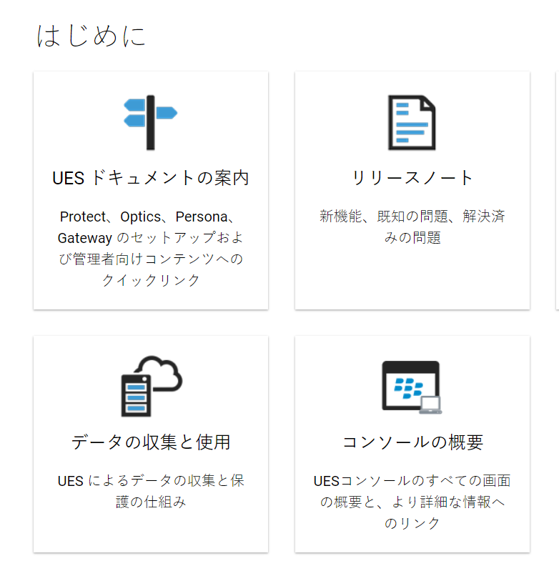
CHALLENGE #3: OPTIMIZE HOW WE LOCALIZE
Dev initiative to localize the console
Localize UES docs for the first time
Rapid release cycles could pose challenges for translation
How to deliver high-quality translated docs on a regular basis without disrupting ongoing work?

Slide 11
CHALLENGE #3: OPTIMIZE HOW WE LOCALIZE
Baseline translation model to export content at a specific point in time
  Allows for ongoing work, no content freezes
  Bi-monthly schedule to pick up changes while managing cost
  Timing allows for proper QA
New standards to make content translation-friendly
  Terminology standards, i.e. “cyber threat” vs “cyber-threat”, “cyberthreat”
  Limited use of screenshots
  Conrefs for product names

Slide 12

CHALLENGE #4: EASE THE TRANSITION
Changes to the location and delivery of docs
Focus on individual products vs. new push for unified solution
Internal groups and customers averse to change
How to transition all of our audiences to the new unified docs?

Slide 13
CHALLENGE #4: EASE THE TRANSITION
Took advantage of CMS integration with the core AEM platform
Intuitive web templates
New resources to help audiences adapt
  “Intro to CES” image
  Navigation resource to map old docs to new
  “Middle-man” pages to offer another layer of navigation

Slide 14
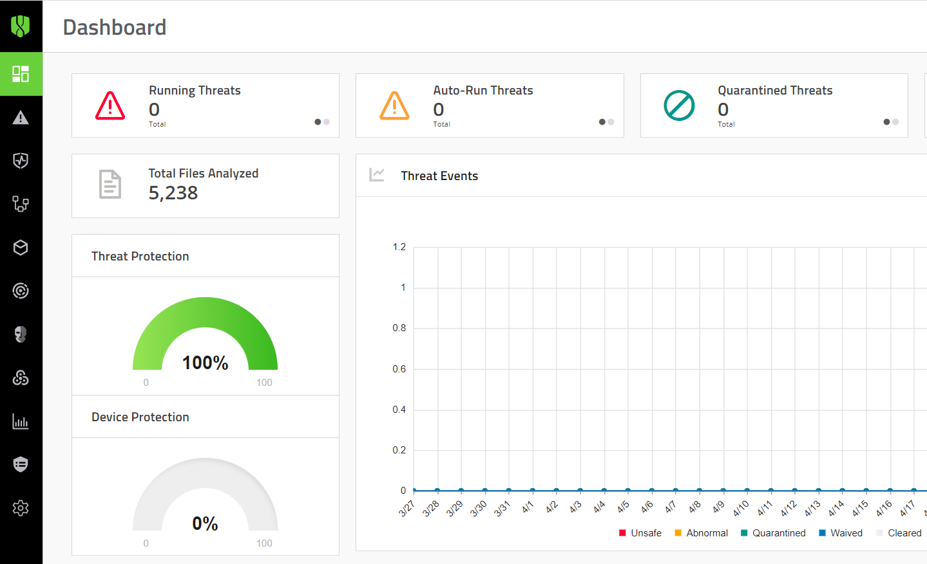
CHALLENGE #5: MAKE THE DOCS PART
OF THE PRODUCT
The age old problem of “I can’t find the docs”
Console lacked connection points to the docs
How to create a clear link between the docs and product itself?

Slide 15
CHALLENGE #5: MAKE THE DOCS PART
OF THE PRODUCT
Addition of context-sensitive help into the console
  Help icon on every screen to redirect customers to the relevant topic in our online docs
  Immediate help at the moment of need
Replacing built-in help strings with a dynamic online resource
  CES console overview
  Expand the content
  Update at any time
  Drive engagement with DITA content

Slide 16

Thank You!
LINKEDIN: Marco Cacciacarro
mcacciacarro@blackberry.com

