Slide 1
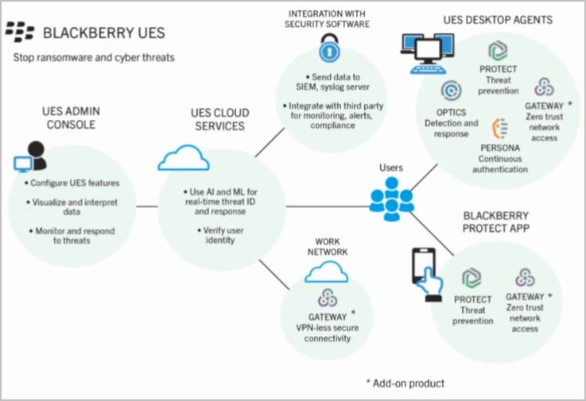
Adobe DITAWORLD 2022:
Marco Cacciacarro (BlackBerry) “From Innovation comes Success”.

Slide 2
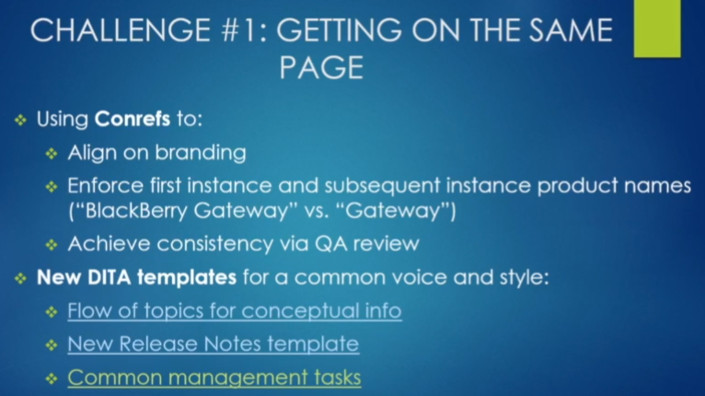
Adobe DITAWORLD 2022:
Marco Cacciacarro (BlackBerry) “From Innovation comes Success”.

Slide 3
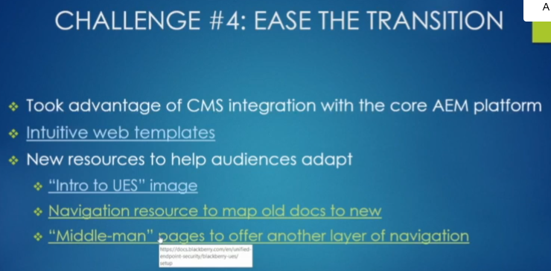
Adobe DITAWORLD 2022:
Marco Cacciacarro (BlackBerry) “From Innovation comes Success”.

Slide 4
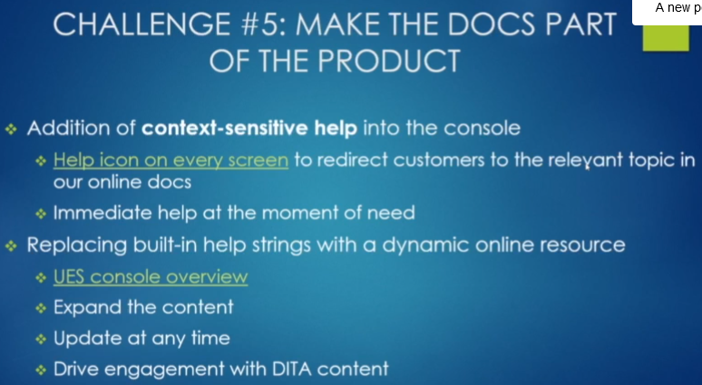
Adobe DITAWORLD 2022:
Marco Cacciacarro (BlackBerry) “From Innovation comes Success”.

Slide 5
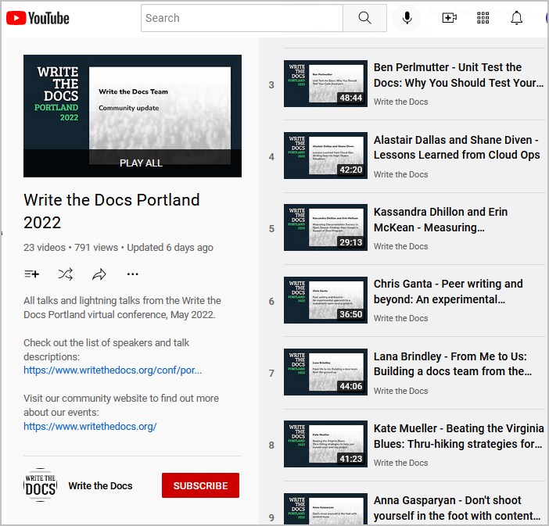
Write The Docs Portland 2022:
YouTube - https://www.youtube.com/playlist?list=PLZAeFn6dfHpnDhFvXG8GprqlLlzSQRBui

Slide 6
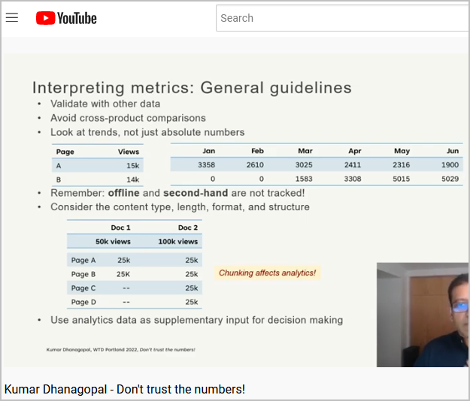
Write The Docs Portland 2022:
YouTube - https://www.youtube.com/playlist?list=PLZAeFn6dfHpnDhFvXG8GprqlLlzSQRBui

Slide 7
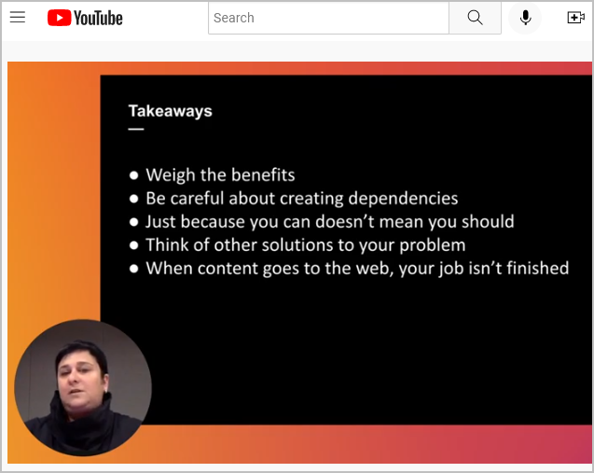
Write The Docs Portland 2022:
YouTube - https://www.youtube.com/playlist?list=PLZAeFn6dfHpnDhFvXG8GprqlLlzSQRBui
Anna Gasparyan – "Don't Shoot Yourself in th Foot With Content Reuse"

Slide 8
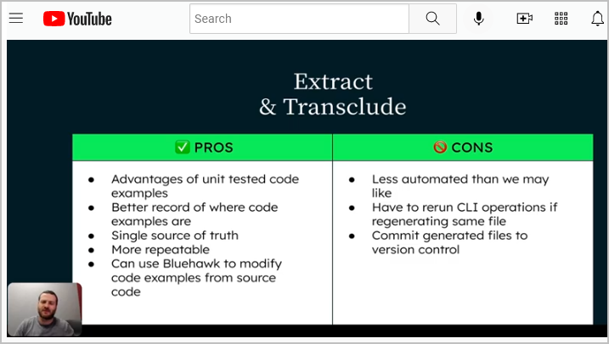
Write The Docs Portland 2022:
YouTube - https://www.youtube.com/playlist?list=PLZAeFn6dfHpnDhFvXG8GprqlLlzSQRBui
Ben Purlmutter – Unit Test the Docs

